Slide 1
ECG dataset & K-Means Clustering
By: Steven Cao

Slide 2
K-means clustering
K-means is a centroid-based algorithm, or a distance-based algorithm, where we calculate the distances to assign a point to a cluster. In K-Means, each cluster is associated with a centroid.
The main objective of the K-Means algorithm is to minimize the sum of distances between the points and their respective cluster centroid.

Slide 3
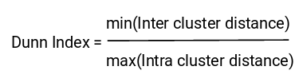
Properties of Clusters
All the data points in a cluster should be similar to each other.
The data points from different clusters should be as different as possible.
The first property of clusters: this is what inertia evaluates. It tells us how far the points within a cluster are. So, inertia actually calculates the sum of distances of all the points within a cluster from the centroid of that cluster.
The second property of clusters: this is where the Dunn index comes in. Along with the distance between the centroid and points, the Dunn index also takes into account the distance between two clusters. This distance between the centroids of two different clusters is known as inter-cluster distance.

Slide 4
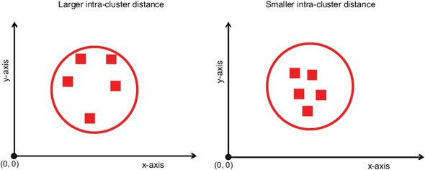
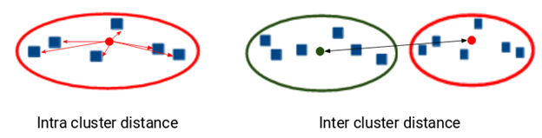

Slide 5
How K-mean works
The way kmeans algorithm works is as follows:
1. Specify number of clusters K.
2. Initialize centroids by first shuffling the dataset and then randomly selecting K data points for the centroids without replacement.
3. Keep iterating until there is no change to the centroids. i.e assignment of data points to clusters isn’t changing.
· Compute the sum of the squared distance between data points and all centroids.
· Assign each data point to the closest cluster (centroid).
· Compute the centroids for the clusters by taking the average of the all data points that belong to each cluster.

Slide 6
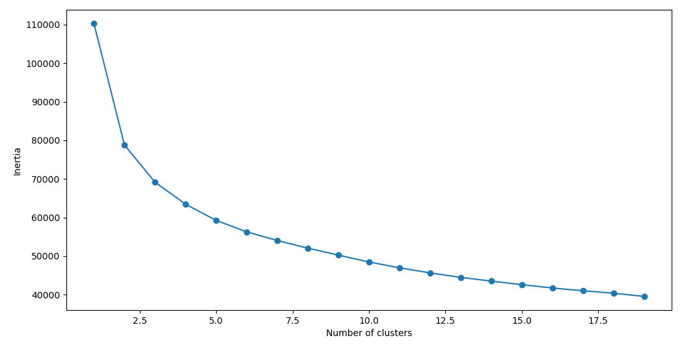
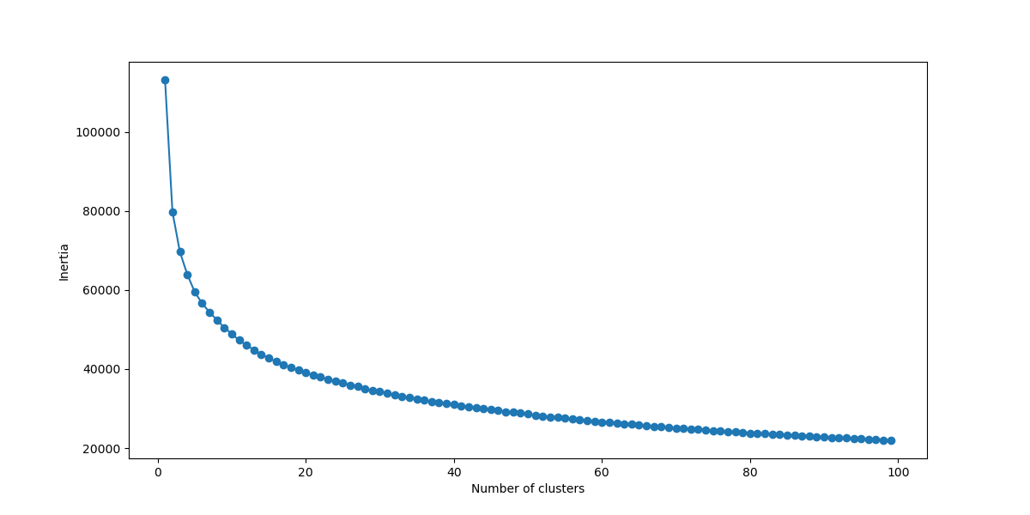
Step #1: specifying number of clusters k
*A good way to find an optimal K number of clusters is using the elbow method and calculating the inertia. *The lesser the inertia value, the better our clusters are. But also understand that the more k clusters their are, the less the value of Dunn index will be which is not want we want.
*

Slide 7
Step #2 Randoming selecting the centriods
*Here, we will randomly select the centroids from the dataset. This is the start the k-mean process.
*Now, you could also manually give the centriods by specifying it. And this is useful if you plotted the data on the graph and see the clusters.

Slide 8
Step #3 Iteration
Compute the sum of the squared distance between data points and all centroids.
Assign each data point to the closest cluster (centroid).
Compute the centroids for the clusters by taking the average of the all data points that belong to each cluster.

Slide 10
Stopping Criteria for K-Means Clustering
There are essentially three stopping criteria that can be adopted to stop the K-means algorithm:
Centroids of newly formed clusters do not change
Points remain in the same cluster
Maximum number of iterations are reached
We can stop the algorithm if the centroids of newly formed clusters are not changing. Even after multiple iterations, if we are getting the same centroids for all the clusters, we can say that the algorithm is not learning any new pattern and it is a sign to stop the training.

